Slide 1
QML for Conspicuity Detection in Production
Team: VG_quantum
Members: Tina Wang, Michael Peters, Bimal Mehta

Slide 2
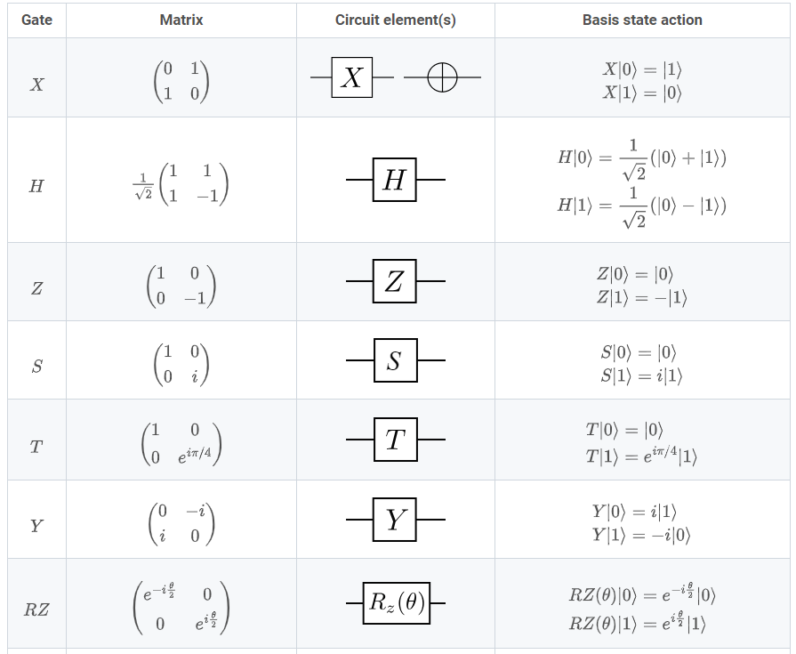
Task 1: Basics of PennyLane
Quantum basics
Single qubit gate
Universal gate sets
Multi-qubits circuit
Entanglement enabled using controlled gates, e.g. CNOT, controlled-U

Slide 3
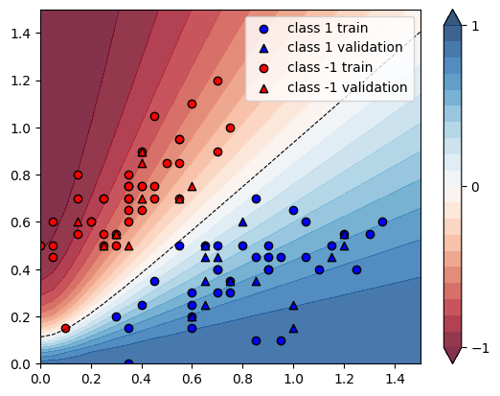
Task 2: Variational Classifier
First classify Parity function f(x)=1 if # of 1 in bitstring is odd, f(x)=0 if # of 1 in bitstring is even.
Predict with 100% test accuracy with 100 steps
Iris Classification with 2 classes

Slide 4
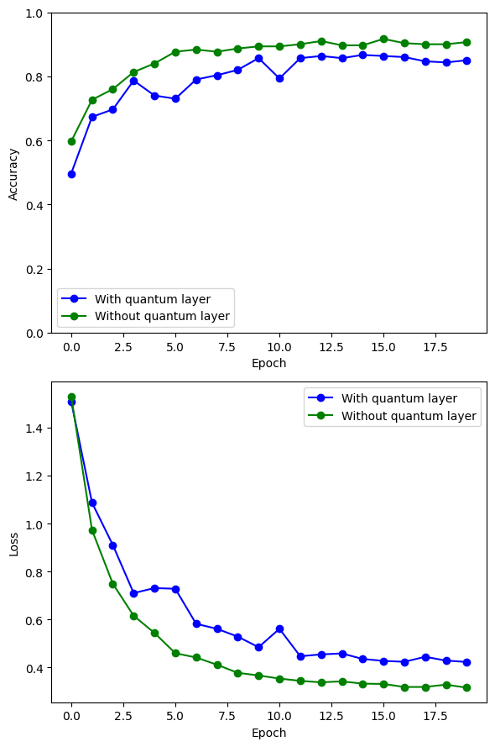
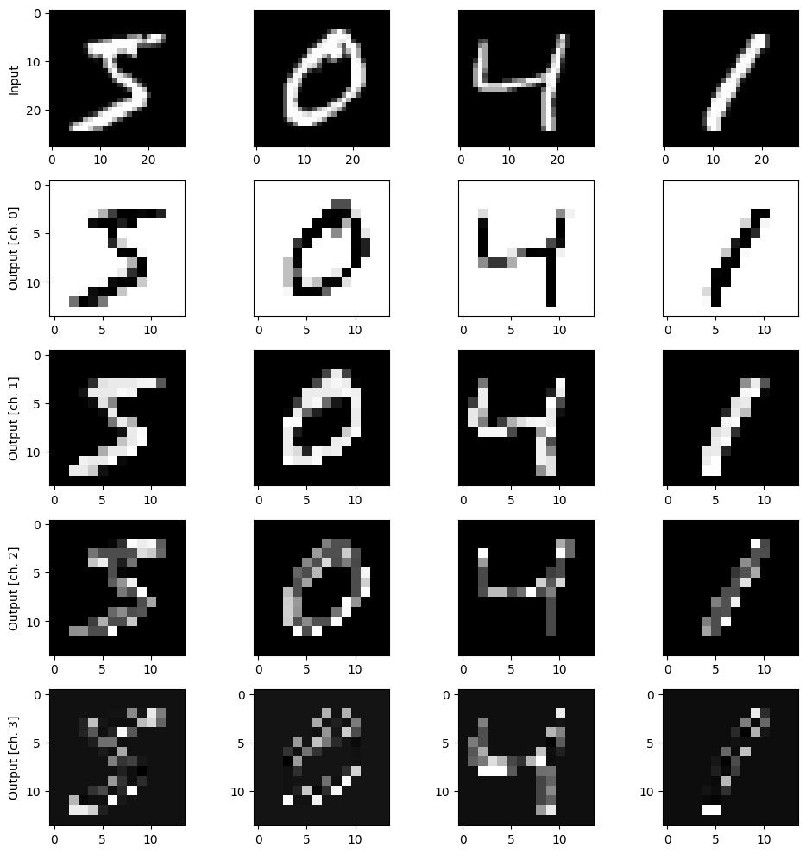
Task 3: Quanvolotional Neural Network
Compared classical benchmark with Hybrid Quantum-Classical network
Encode classical 4*4 pixel into quantum information

